Slide 1
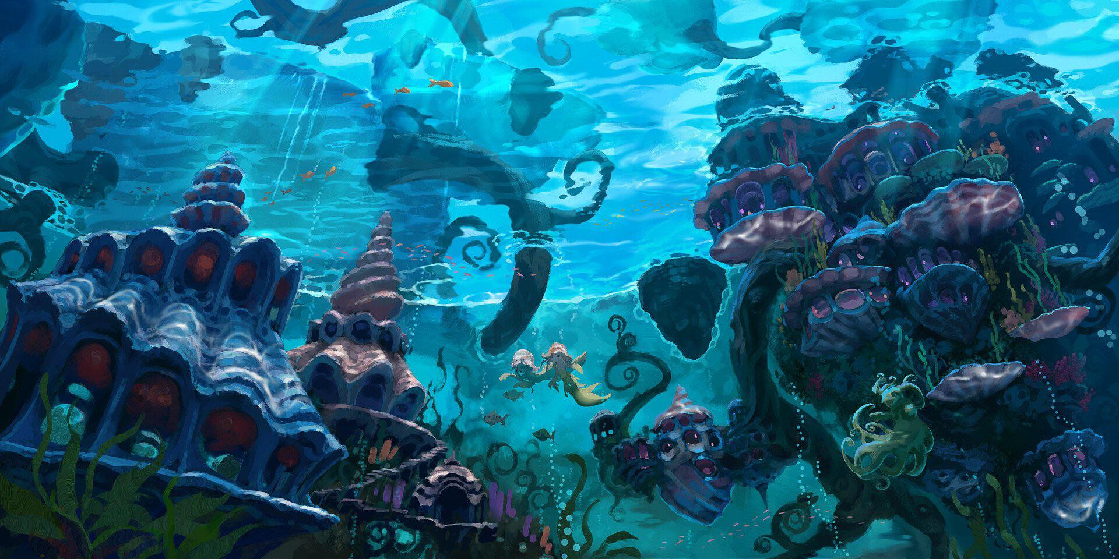
SOUND ON – PRESENTATION MODE ON

Slide 2
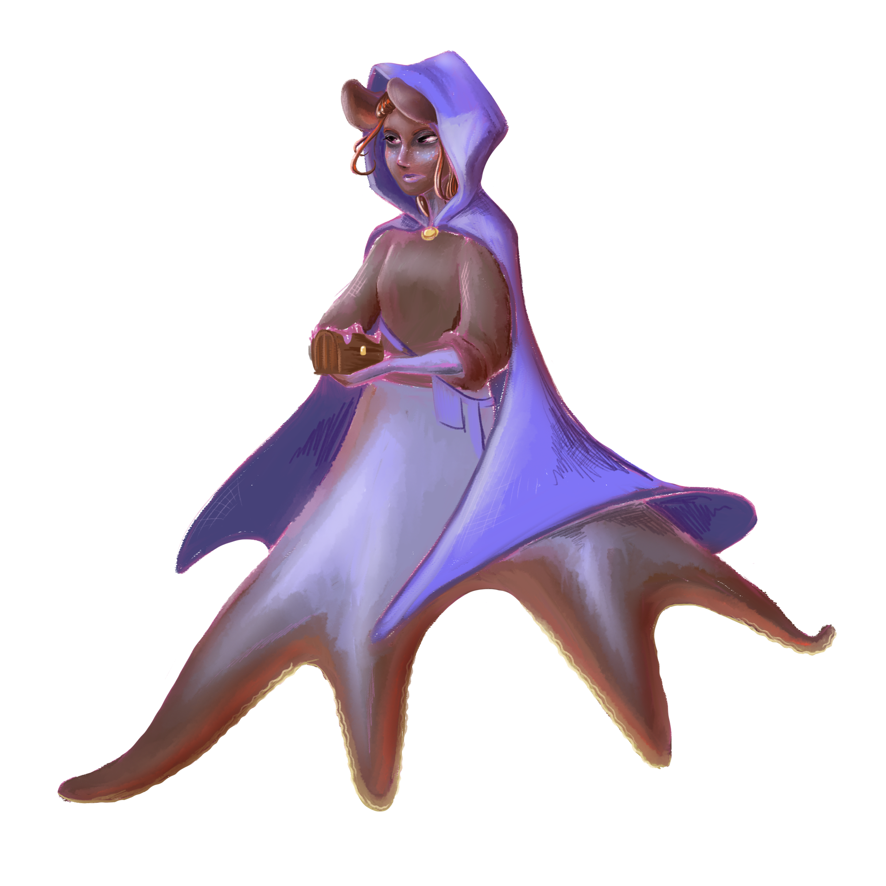
Introduction
Octopean is a single-player strategy stealth game. Playing as Sylvie, inhabitant of Tide City and member of the infamous Octopean crime syndicate, your goal is to infiltrate your rival organization, the Squids, and steal their most prized possession: a powerful weapon known only as the Key.
Your goal will be accomplished in two key ways: through reconnaissance and stealth missions. Both will be aided primarily by your abilities to disguise yourself and to walk on walls and ceilings.
Tone: Tense, mysterious
Theme: The best approach isn’t always the most obvious one

Slide 3
Tide City
Tide City is a strange and dangerous place, harboring all manner of unusual characters and their secrets.
Most inhabitants have allied themselves, for any number of reasons, with one of Tide City’s factions—the most powerful of which are the Octopeans, the Squids, and the city guards, all of whom are mutual rivals.
After recently rising in the Octopeans’ ranks, Sylvie has been assigned her most dangerous task yet: track down and steal the Squids’ Key, before it can be used to destroy the Octopeans or even Tide City itself.

Slide 4
Faction Relations
HIGH POPULARITY
LOW POPULARITY
LOW NOTORIETY
HIGH NOTORIETY
The more time Sylvie spends in Tide City, the more familiar she’ll get with its inhabitants—for better or for worse. Completing tasks to help a faction will increase popularity, while completing tasks that harm a faction will increase notoriety.
High popularity means Sylvie will be offered special quests, information, and access to restricted areas, while high notoriety will heighten the consequences of getting caught during a quest but will greatly increase the reward for succeeding.
Reaching a threshold of either popularity or notoriety with a faction will allow Sylvie to learn the ability to mimic them.

Slide 5
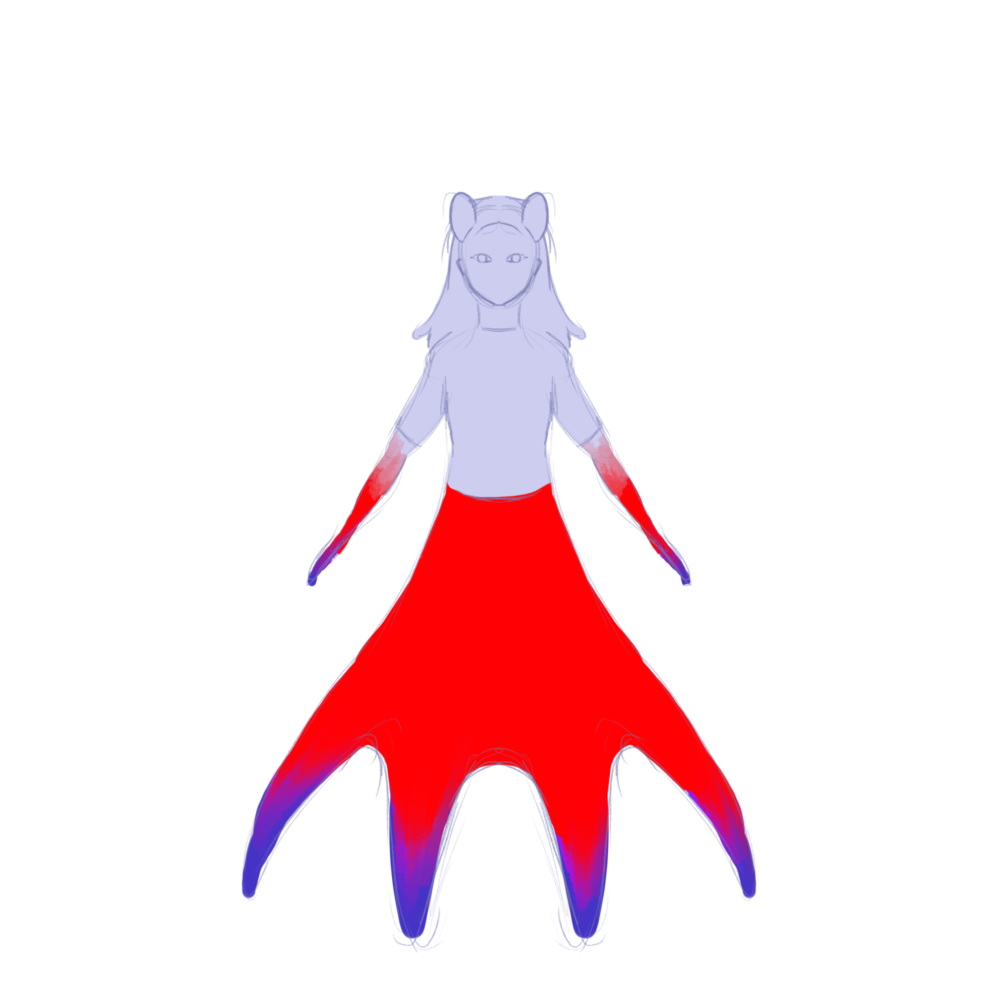
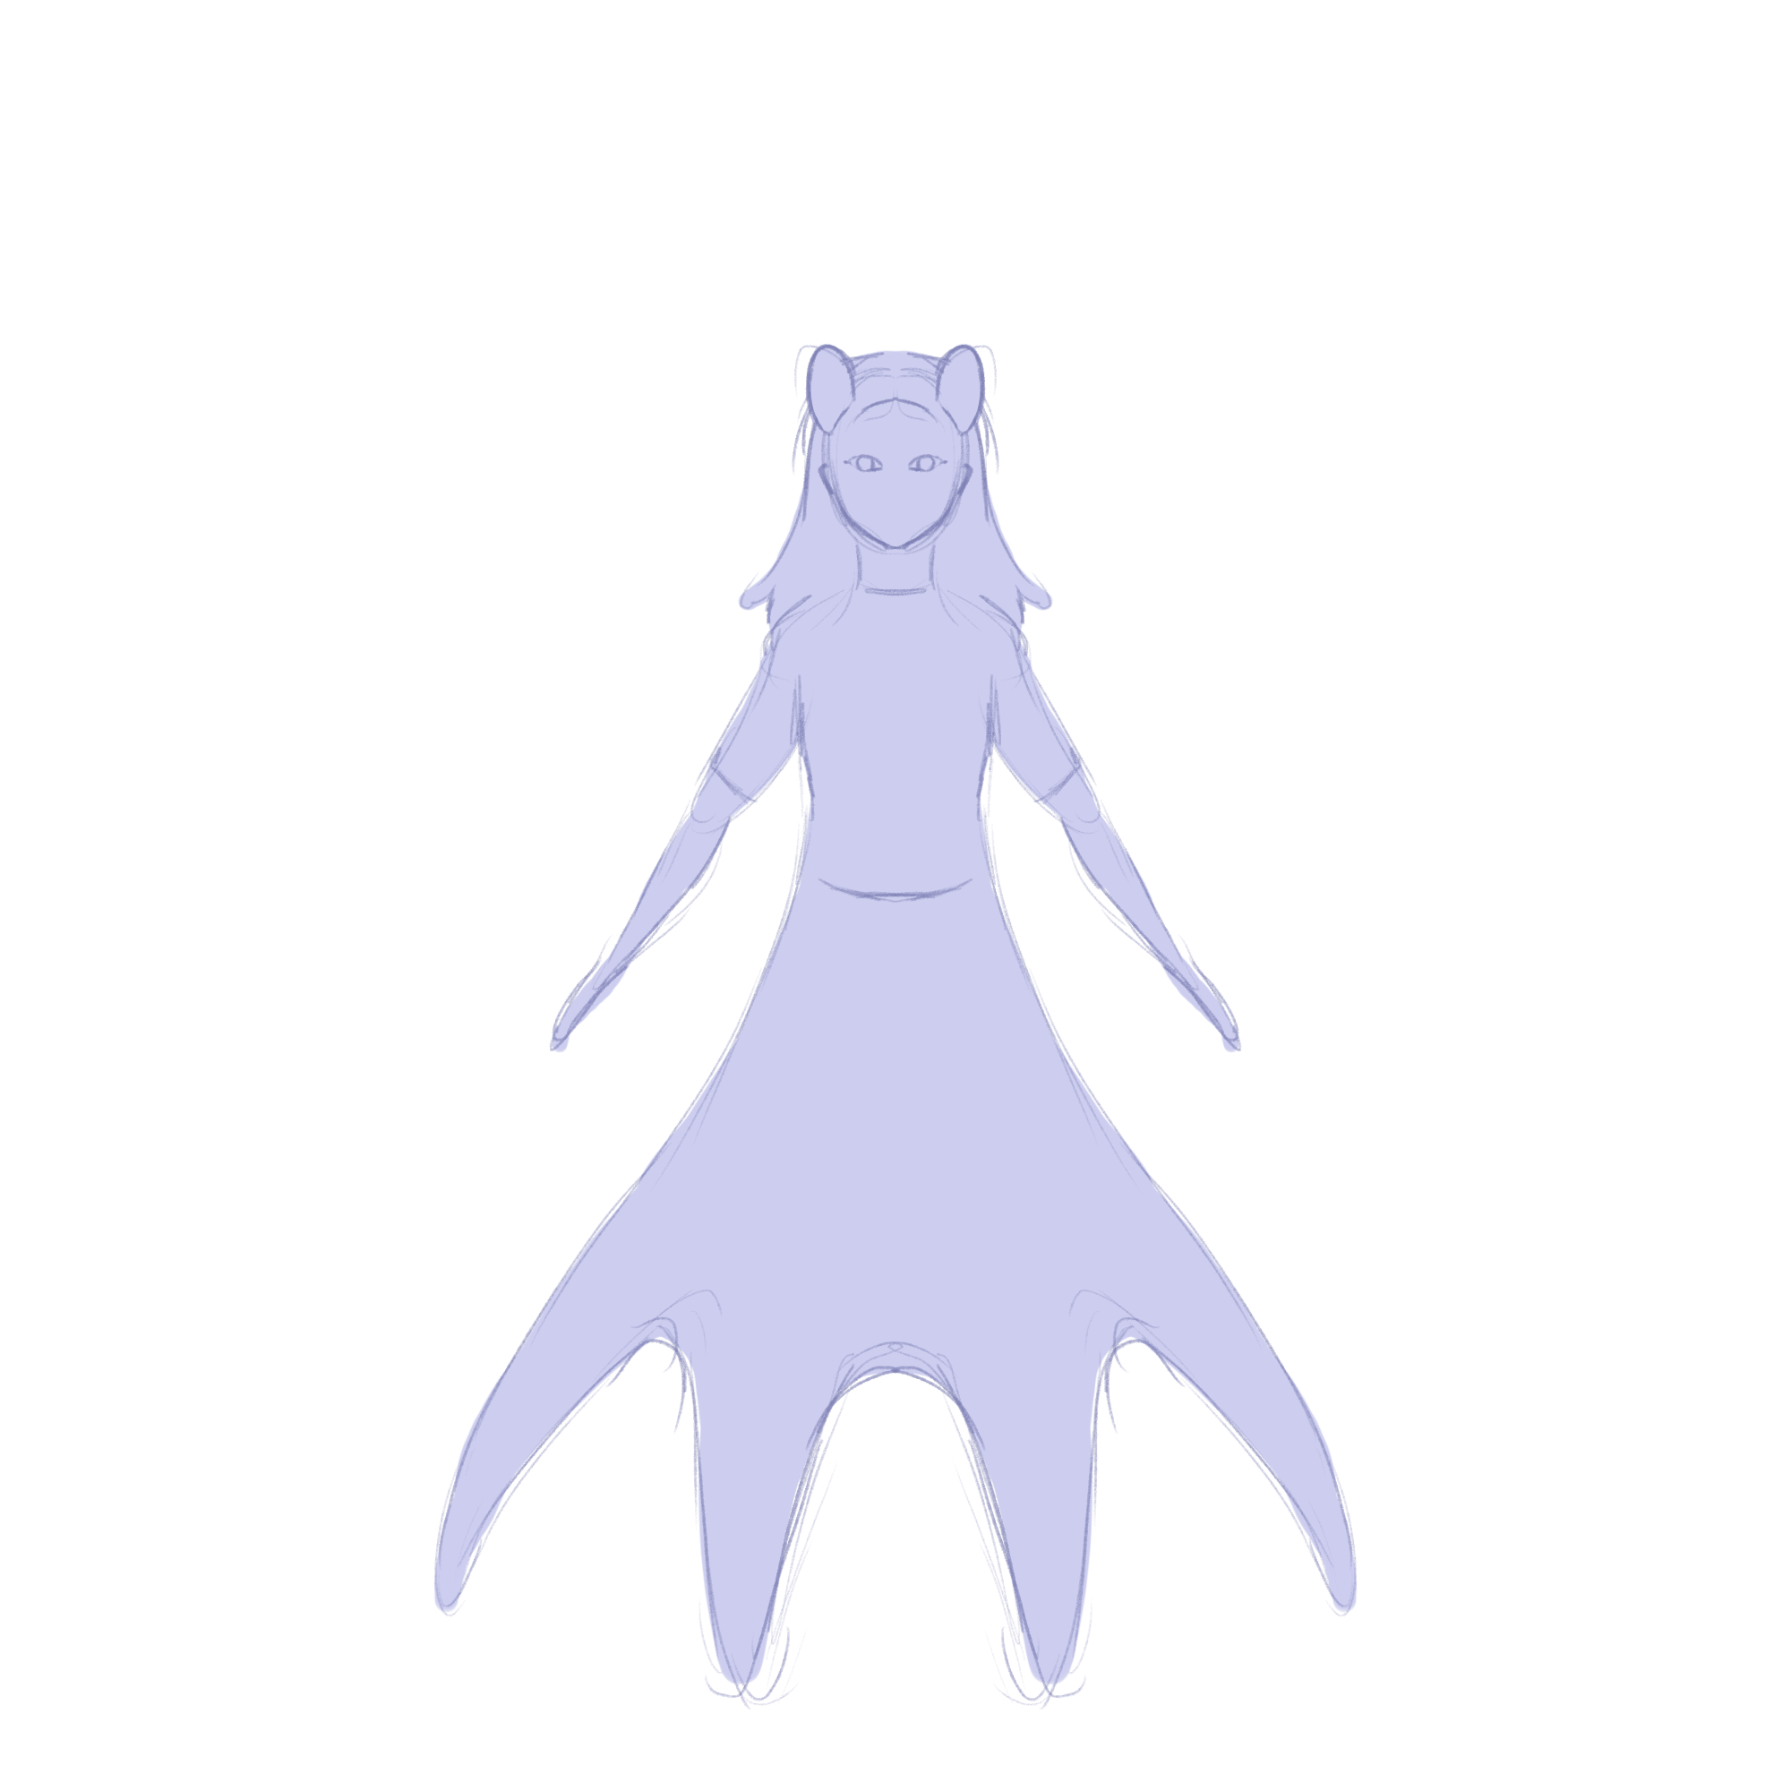
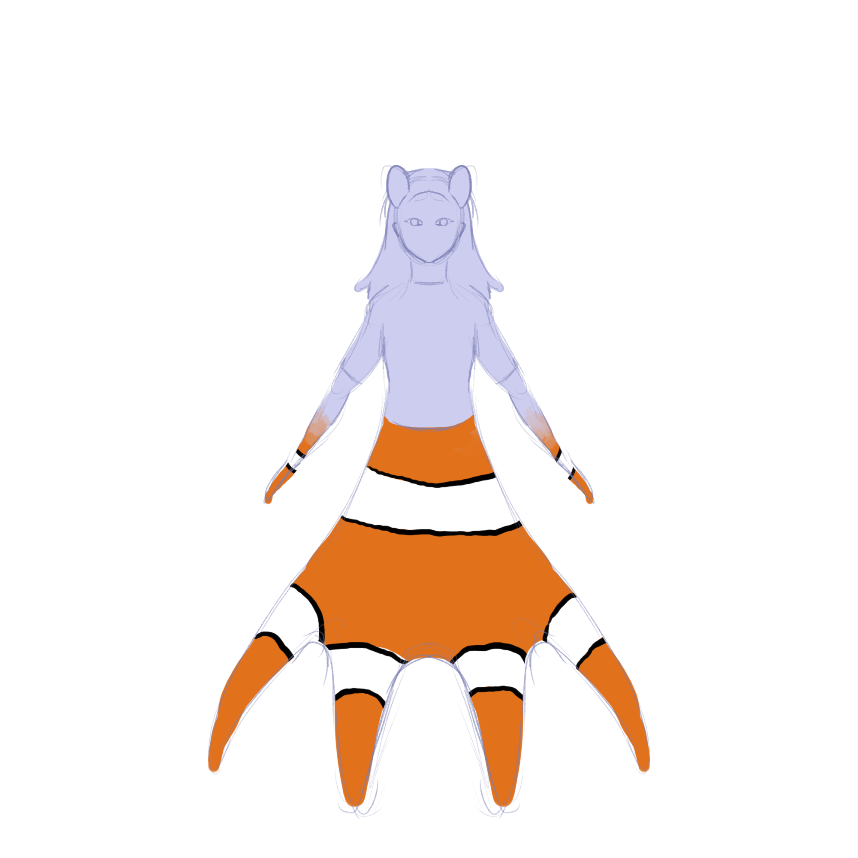
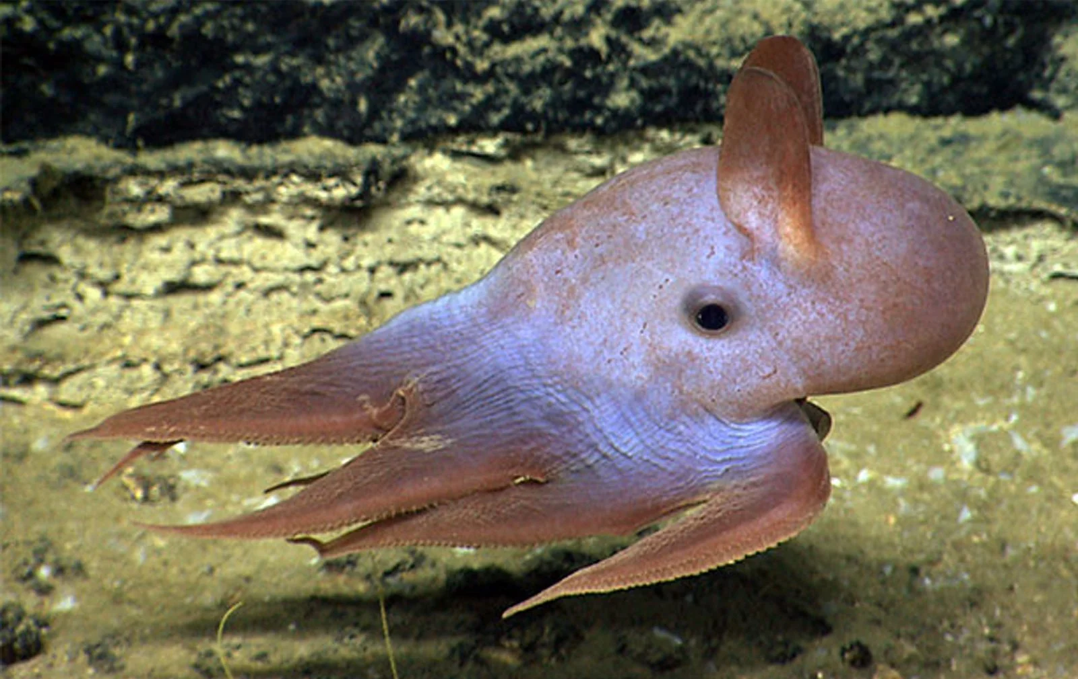
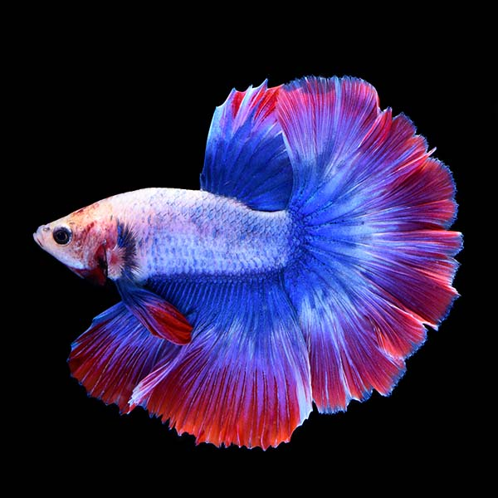
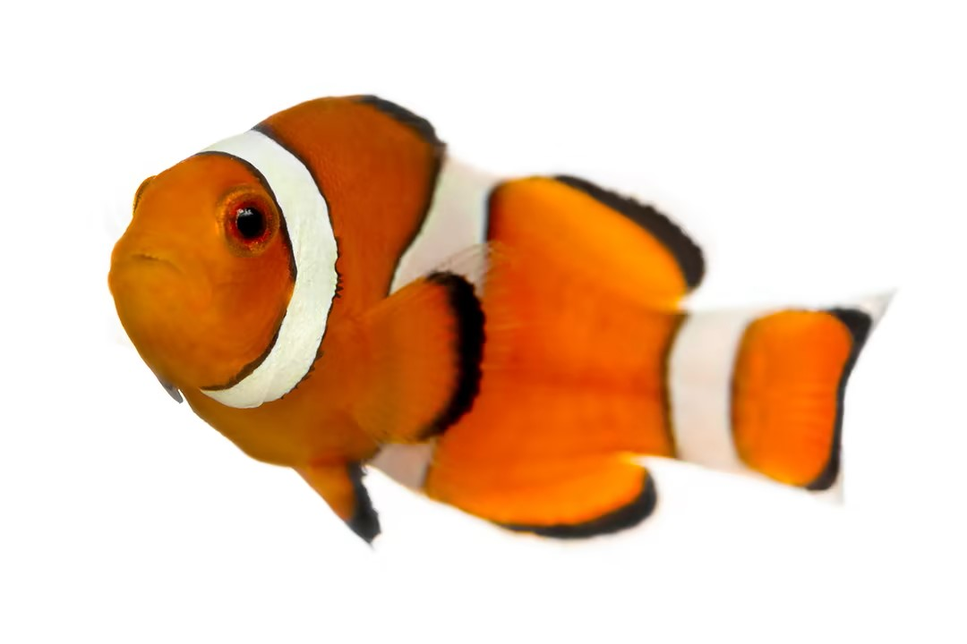
Disguises
As an octopus, Sylvie has the innate ability to change colors for short periods of time, allowing her to blend into her surroundings and making her much harder to spot. However, she also has a unique ability: once she grows familiar enough with a faction, she will learn the ability to mimic that faction in the form of a disguise.
Disguises allow Sylvie to pass herself off as a member of that faction for short times, gaining access to private events and restricted areas.
Notoriety has a lower threshold for learning disguises, but the disguise is more likely to be spotted by the faction; conversely, it takes more popularity to learn a disguise, but disguises will hold up better with factions you’re in good standing with.

Slide 6
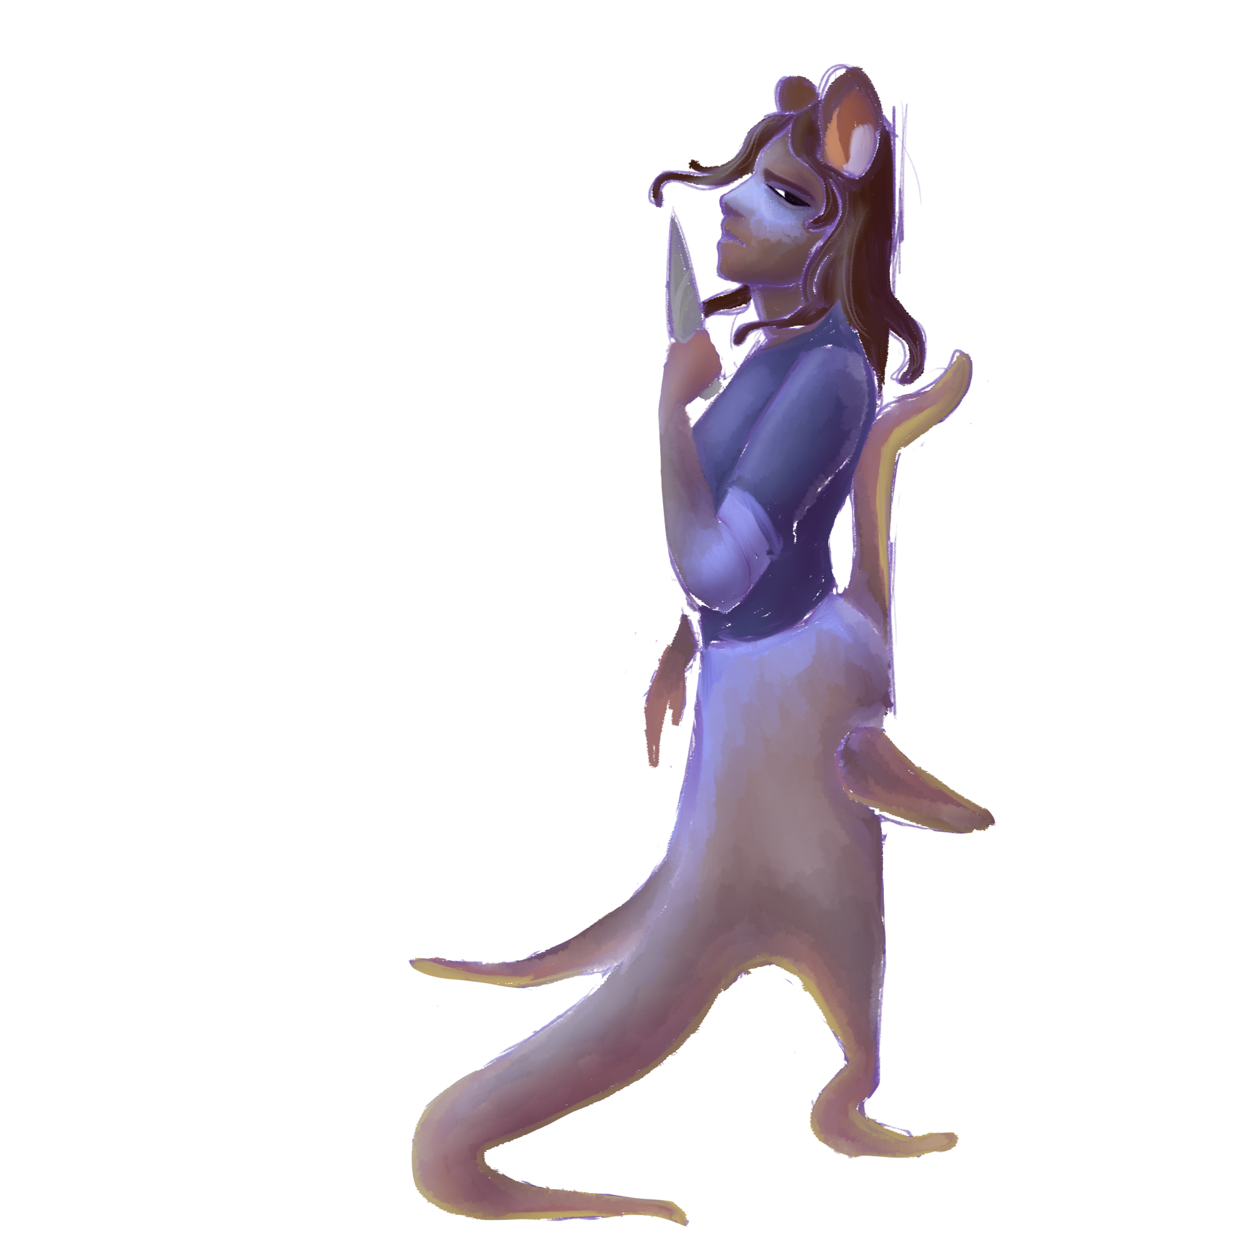
Movement
Sylvie has two primary forms of movement: swimming and terrain traversal.
Swimming allows her to travel through Tide City more quickly and flexibly, but she can’t disguise herself while swimming.
While moving across terrain, Sylvie is slower, but she is harder to spot and can disguise herself.
Because of her tentacles, Sylvie can move equally easily across floors, ceilings, and walls.

Slide 7
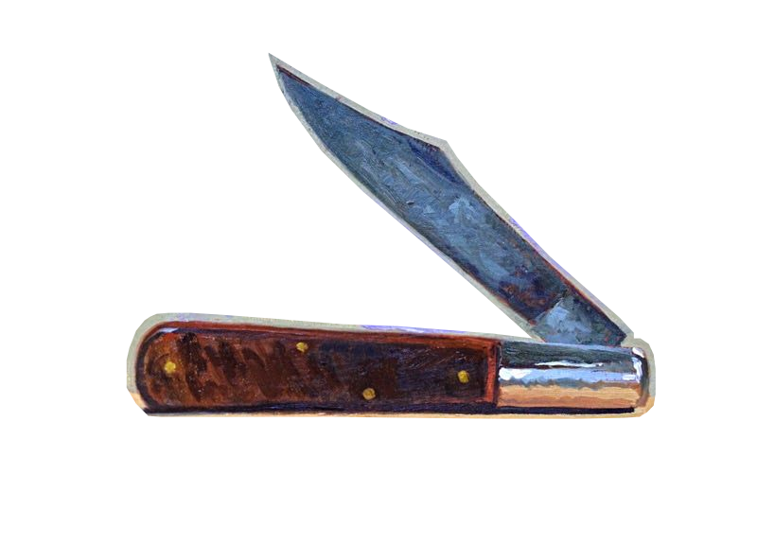
Combat
Sylvie is just one person, and the squids are highly trained, so although engaging in direct combat is possible, it’s highly discouraged.
As a measure of protection, Sylvie carries her pocketknife everywhere she goes—it’s intended for cutting ropes and cables, but in a pinch, it can be used in self-defense.
Sylvie’s notoriety with the city guards will skyrocket if she lands a killing blow, making it much more likely for the city guards to notice her and try to pick her off, so engaging in fights is recommended only as a last resort.
Neither Sylvie nor other city dwellers have HP; damage is determined based on the location of the hit, with the head and chest being killing blows.

Slide 8
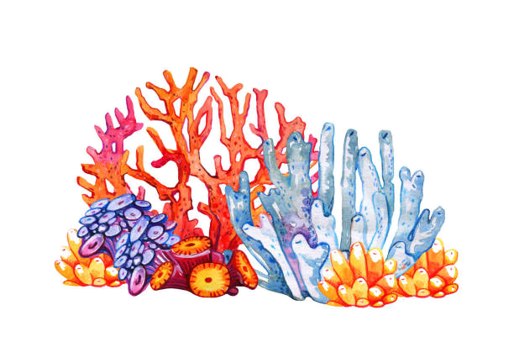
Gear and Upgrades
After completing quests and earning gold, Sylvie can head to the Coral Collective to purchase and upgrade gear. Those coral polyps are industrial little guys—along with building the reef they live in, they can produce and modify all sorts of coral gear, such as lights, decoys, and wearable armor and accessories.

Slide 9
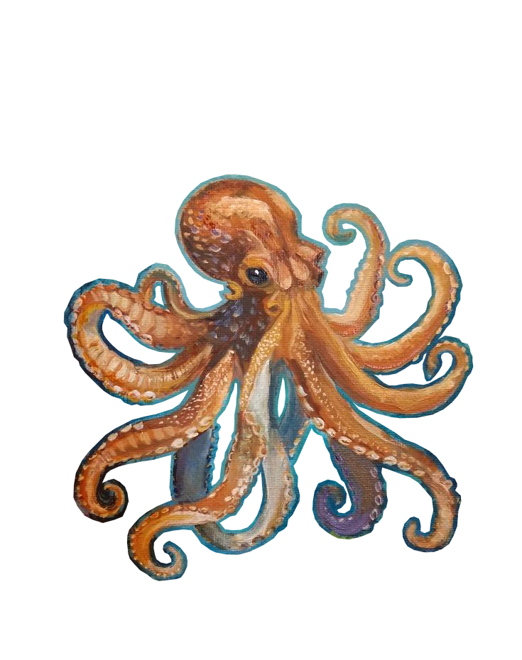
Quest Loop
COMPLETE RECONNAISSANCE
RECEIVE QUEST
RECEIVE REWARDS
EXECUTE TASK

Slide 10
Quests
Example Quest
Both the main storyline and smaller side stories are structured into quests. Quests are triggered to begin through the completion of previous quests in a sequence, by talking to other characters during reconnaissance, or by observing elements of the environment.
Most quests are structured around a heist, and many are broken into multiple segments. Completing smaller requests might lead to a small monetary reward, while larger quests can unlock special disguises and gear.
RECEIVE QUEST
The leader of the Clownfish, Edgar, needs help retrieving his stolen watch.

Slide 11
Quest Loop
COMPLETE RECONNAISSANCE
RECEIVE QUEST
RECEIVE REWARDS
EXECUTE TASK

Slide 12
Reconnaissance
Example Quest
Most quests begin with a reconnaissance phase. Quests are often given as a simple request, without much additional information, leaving it up to Sylvie to piece together the details. Common details to fill in include:
Who is involved?
Where will the quest take place?
When will the quest take place?
Smaller quests will often be more lenient on location and timing, but quests within the main storyline are more strict, requiring Sylvie to keep careful tabs on timing and location.
Quests completed outside of their ideal timeframe will be more difficult and occasionally have higher consequences.
RECEIVE QUEST
The leader of the Clownfish, Edgar, needs help retrieving his stolen watch.
RECONNAISSANCE
Speak to people around town and discover that the watch has been spotted, worn by a Squid.

Slide 13
Quest Loop
COMPLETE RECONNAISSANCE
RECEIVE QUEST
RECEIVE REWARDS
EXECUTE TASK

Slide 14
Stealth
Example Quest
The primary focus of most quests is stealth—often to the means of stealing, but sometimes with goals like breaking into a space, rescuing somebody, or infiltrating a formal event.
Sylvie is uniquely suited to these tasks, and has a set of unique skills at her disposal:
Disguises learned through other quests
Gear and equipment, bought or commissioned from the Coral Collective
The ability to change colors to blend into the environment
The ability to move across any surface—floors, walls, and even ceilings
RECEIVE QUEST
The leader of the Clownfish, Edgar, needs help retrieving his stolen watch.
RECONNAISSANCE
Speak to people around town and discover that the watch has been spotted, worn by a Squid.
STEALTH
Disguising yourself as a squid, infiltrate a gathering. Sneak close enough to the head Squid to steal back the watch.

Slide 15
Quest Loop
COMPLETE RECONNAISSANCE
RECEIVE QUEST
RECEIVE REWARDS
EXECUTE TASK

Slide 16
Rewards
Example Quest
Completing a quest within the main storyline can unlock access to new sections of the tide pools, upgraded gear, and additional quests.
Side quests provide money and gear.
Notoriety/popularity with the tide pools’ factions are both updated at the end of each quest; as a result, new disguises can also be unlocked at the end of a quest.
RECEIVE QUEST
The leader of the Clownfish, Edgar, needs help retrieving his stolen watch.
RECONNAISSANCE
Speak to people around town and discover that the watch has been spotted, worn by a Squid.
STEALTH
Disguising yourself as a squid, infiltrate a gathering. Sneak close enough to the head Squid to steal back the watch.
REWARD
As thanks for returning the watch, Edgar offers you 20 gold. Your popularity improves.

Slide 17
Audience
Psychographic
likes action
prefers slower-paced strategy over fast-paced, high-octane combat
not necessarily out for blood but appreciates a good revenge arc
thinks before they act, sometimes to the point of overthinking
appreciates aesthetics and more conceptual ideas
analytical; notices and assigns meaning to even meaningless details
After being laid off from his cushy IT job, Jim has been floating between careers for a few months. He was known around his last workplace for having somewhat of a prickly personality; despite his otherwise very successful time on the job, he had difficulty connecting with his coworkers and ended up being one of the first to go when the company began to lose money. Despite this, he has a very tight-knit group of like-minded friends outside of work, most of whom he’s known for many years. Jim has a strong set of beliefs, but if somebody presents a rational enough argument, he’s willing to challenge those beliefs. Outside of work, he spends much of his time and money on constructing intricate, miniature replicas of famous buildings.

