Slide 1
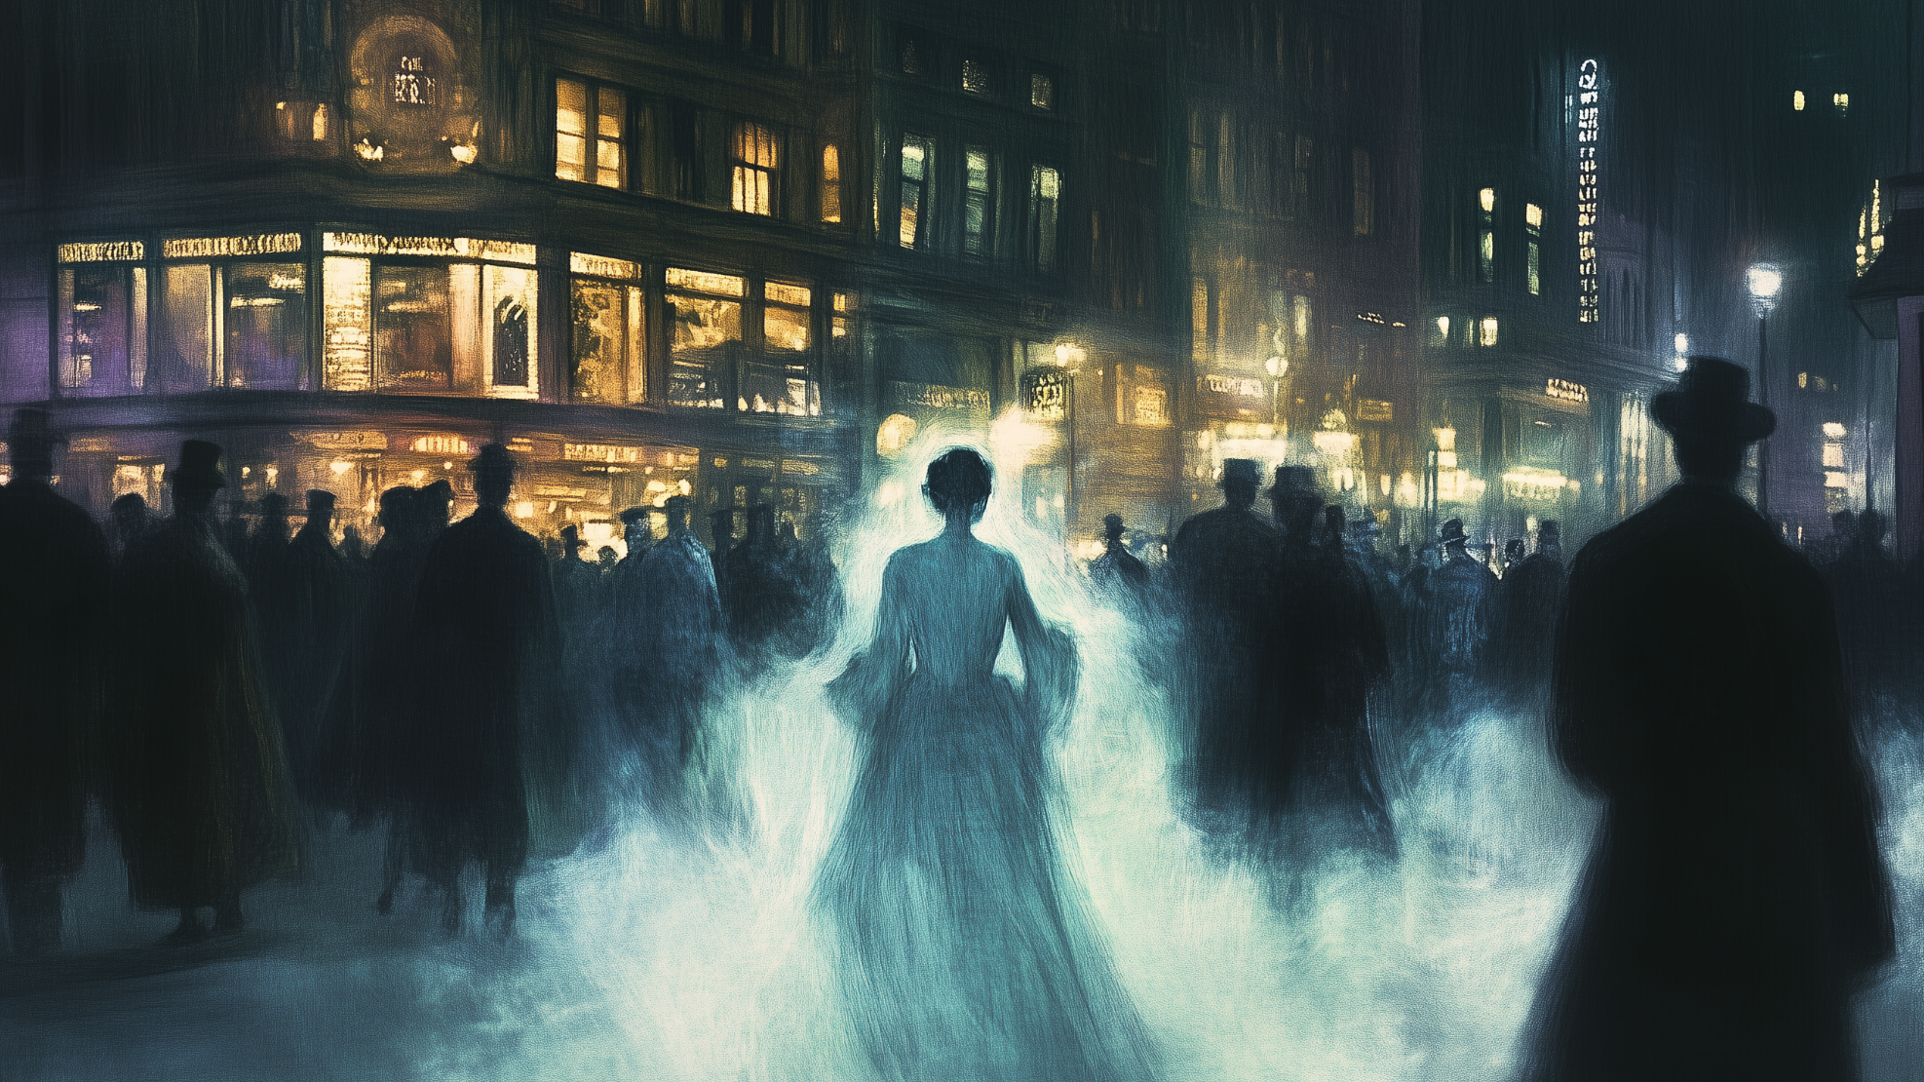
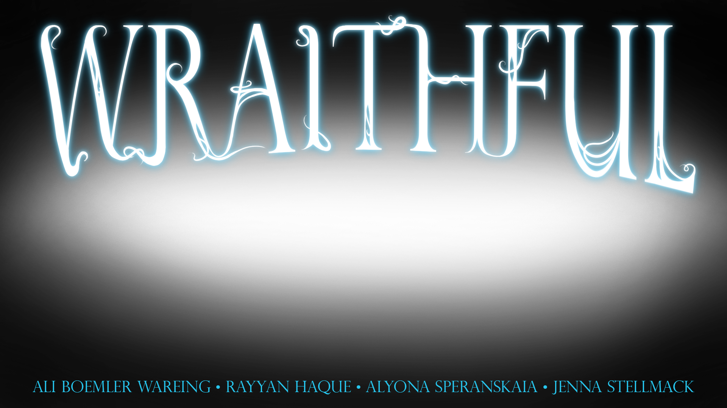

Slide 2
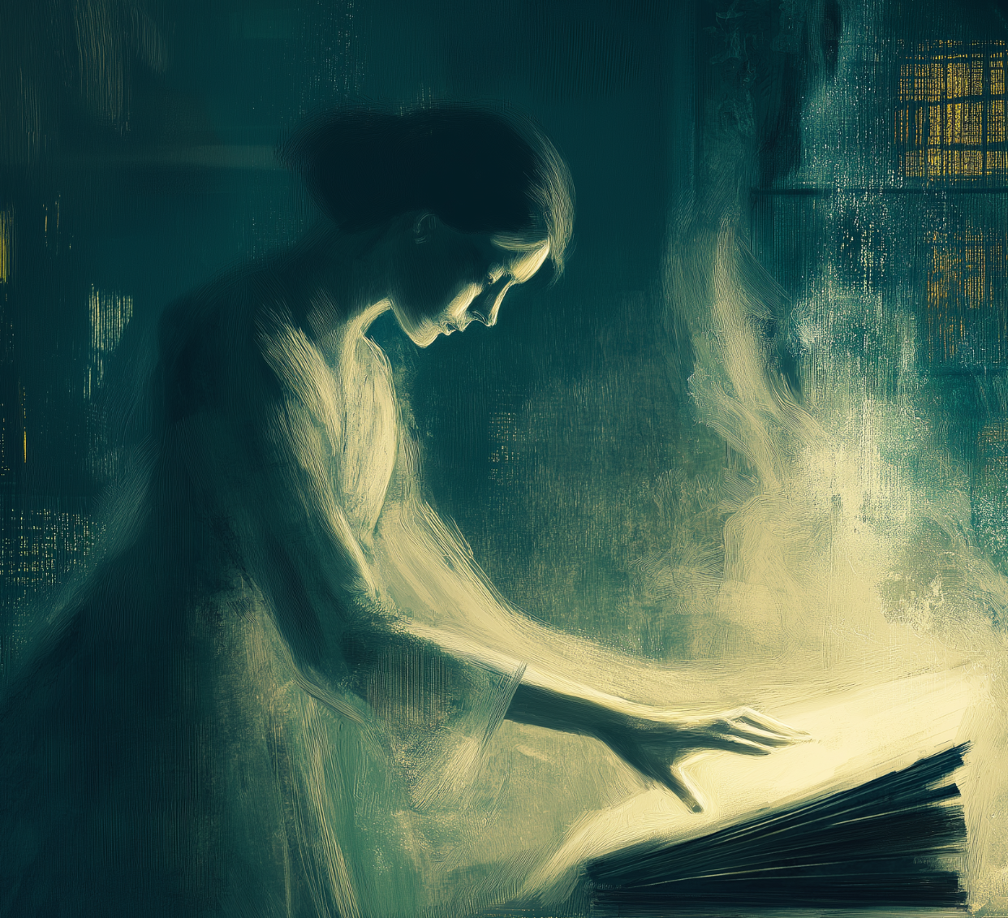
After her body is possessed by a malevolent being, a spirit must hunt down her stolen body. As a spirit, she's noncorporeal, but by possessing the right people at the right times, she can gather information and interact with people and objects to find and take back her body.
But how many people can she possess before she becomes as much of a monster as the being she hunts?

Slide 3
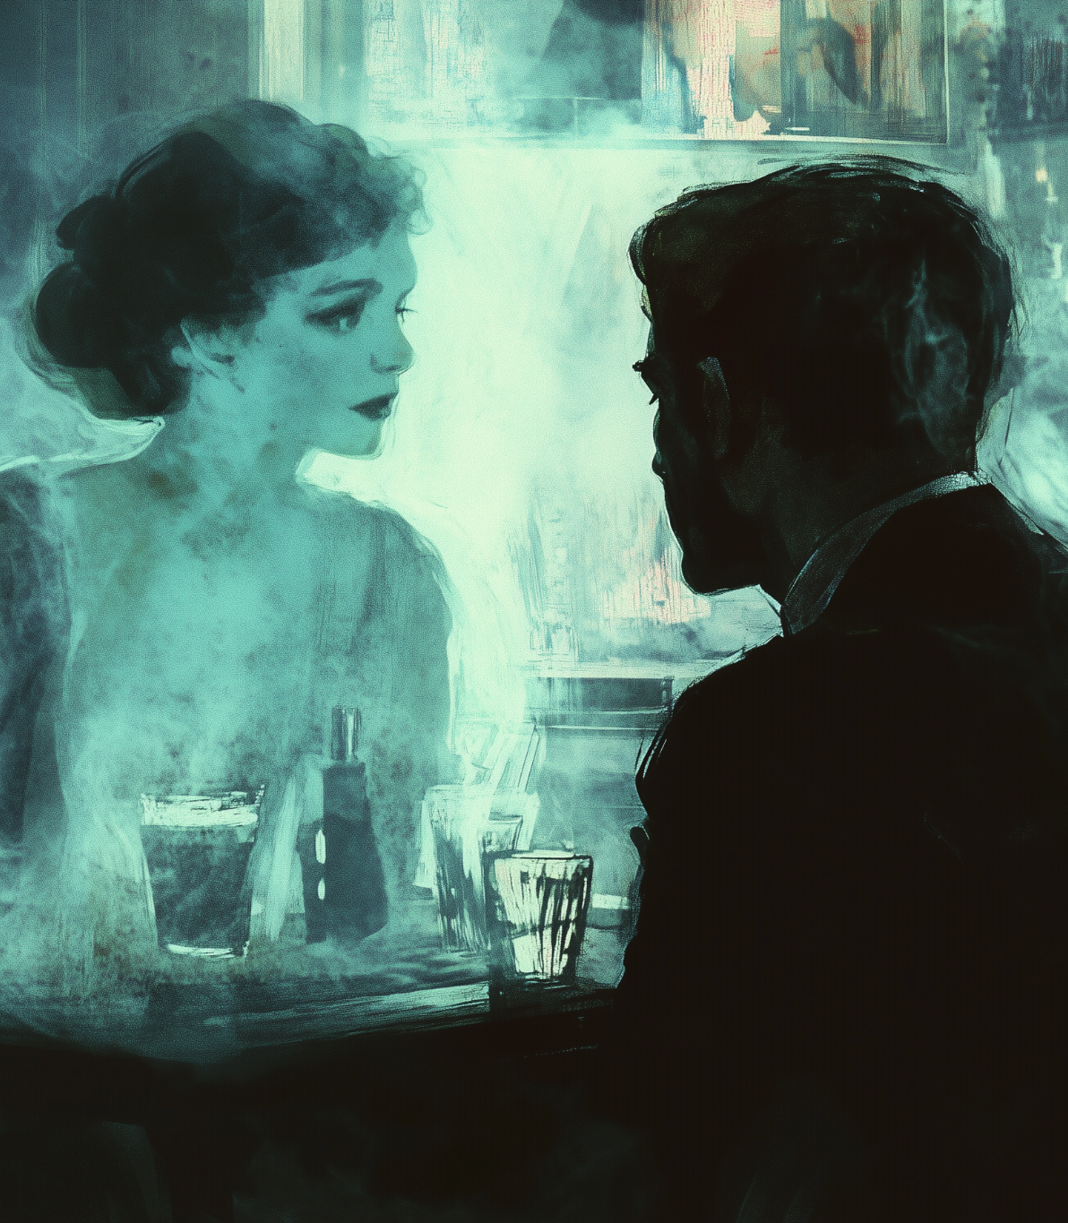
Wraithful is a single-player supernatural puzzle RPG set in Prohibition-era New York. Playing as Dorothea, a woman who has had her body taken over by a rogue demon, the player must track down Dorothea’s body by possessing other people and gathering clues to both the location of her body and the means of taking it back.
Tone: Moody, grim, morally gray
Theme: Who are we behind the mask?

Slide 4
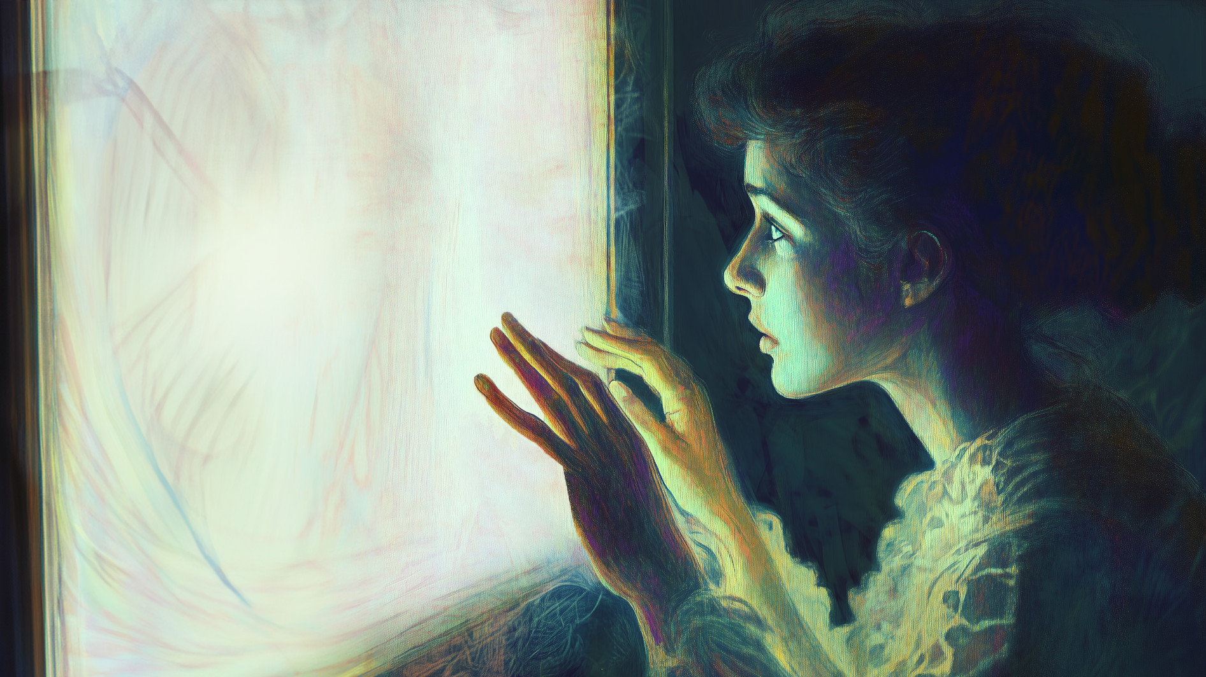
Audience
Introverted—comfortable by themselves
Comfortable with their own thoughts, but not antisocial
Want to know the answer to every question—will search out answers persistently enough to annoy others
INTP
Daydreamers, yet hardworking; passion-driven
Prefer fiction with gray morals
See personalities as puzzles
Like intellectual stimulation, freedom and puzzles
Achievement-driven
Fictional role players

Slide 5
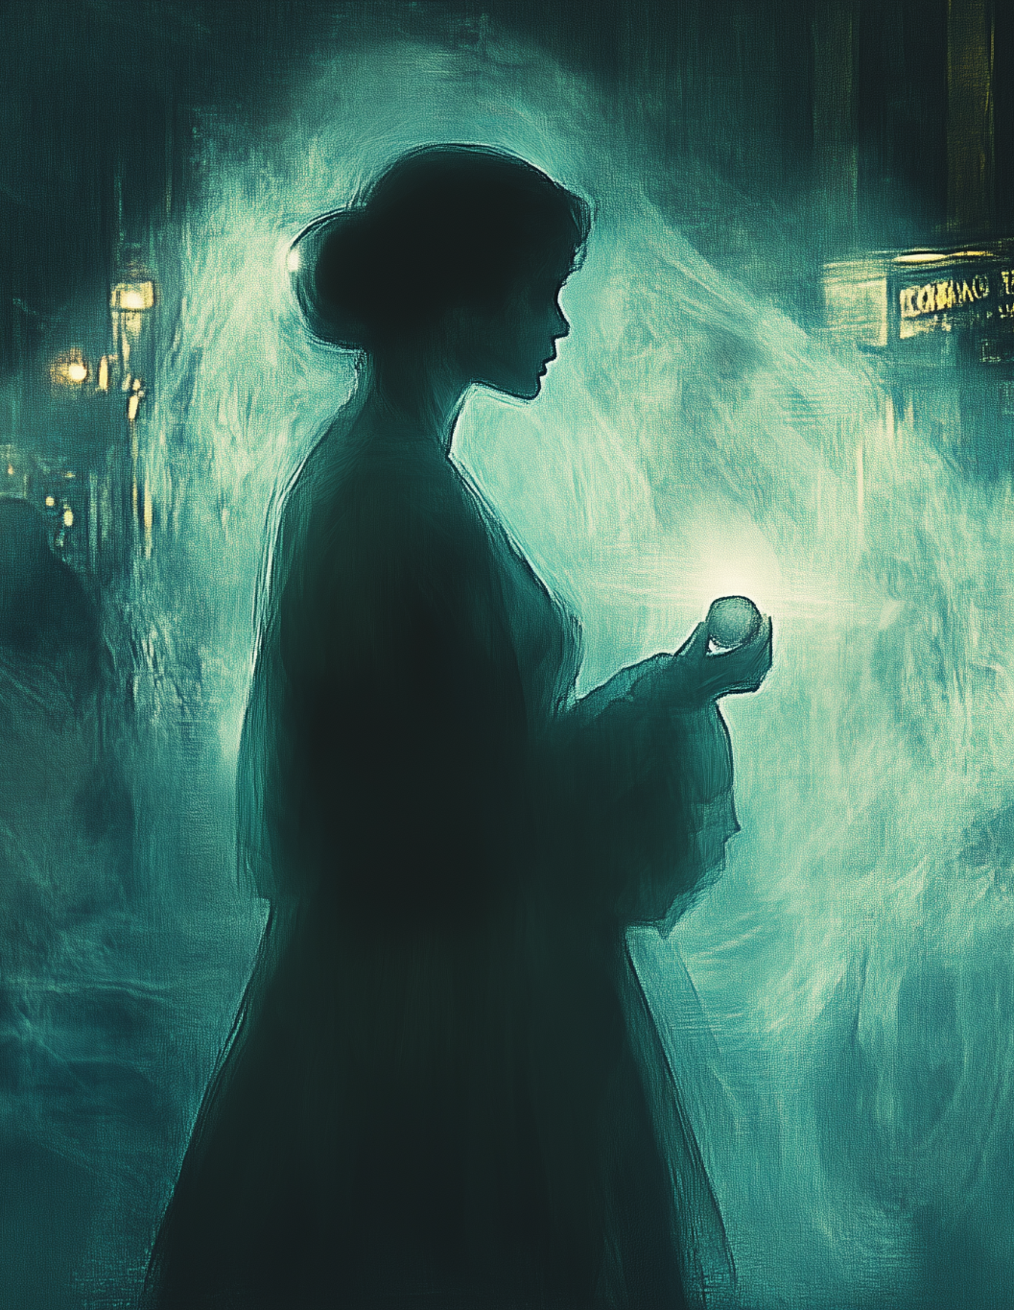
Psychographic
Isabel is in her mid-twenties and just starting her first job as an entry-level industrial-organizational psychologist. She initially struggled to find a job when she left college, but ended up landing a job with a small firm several states away from her family. As a bit of a homebody, it’s the first time she’s lived away from her family; she’s had trouble adjusting socially, since she tends to stick to her small circle of friends as much as she can. In her free time, Isabel is trying to learn the guitar, and she takes some time every weekend to visit a small local bookshop near her new apartment to browse the new releases. Although the owners recognize her easily, they’ve never spoken to her for long enough to learn her name.

Slide 6
Constraints
Explicit descriptions of game choices, hints at consequences
Limited amount of shocking content
A more structured approach to quests (audience seems to like their habits and their routine)
Focus on fiction, subverted tropes, morale questions and novelty
Quests could be structured as mysteries, letting the player find answer through gathering “clues”; each quest must leave the player with an unanswered question

Slide 7
Mystery
Solving
Possession
Puzzles

Slide 8
Possession
As the primary mechanic, Dorothea can take control over a person and use their abilities to navigate through the level or extract any info they might have
Reveal parts of the map
Give hints/clues about the current roadblock
The ability to conversate with people related to the possessed to better understand them.
Gain a permanent clue to the ongoing mystery behind spirits and the physical world itself.
However, some are not so readily possessible. These people are aware of the existence of spirits and have protections that prevent them from being possessed and may even hinder the player if nearby.
To make matters worse, if they become suspicious, they may try to search for and capture Dorothea.
However, the player can possess objects to evade detection.

Slide 9
Mystery
Solving
Possession
Puzzles

Slide 10
Puzzles
All levels share a goal of reaching and possessing one of the demon’s lackeys in order to piece together the answer to how to get her body back.
The levels are designed around exploration and experimentation, as the player will try to possess and utilize the host’s abilities to get closer to the target or learn more about the map.
Ex. Possessing a VIP in order to get through the guards with ease, possessing a server to understand a part of the map layout for the kitchen
The existence of spirits are known by few which means the player has to be wary of being suspicious near them lest they risk being captured.
There may be areas that are inconspicuously locked against spirits, requiring the player to possess people with those clearance to get through or possess those who might know how to bypass it.

Slide 11
Mystery
Solving
Possession
Puzzles

Slide 12
Mystery Solving
Thrust into a world known by few, Dorothea must do all she can to understand her predicament and find a way out of it.
Why did the spirit take control of her body?
Who else knows about the spirits?
Eventually as the game progresses, what is the spirit conspiring and was her possession truly random?
Clues are found in various aspects of the environment, including people, as spiritual possession allows the spirit to obtain a portion of their memories.

