Slide 1
FIRST PLAYABLE
AIR TRAFFIC CONTROL SIMULATOR

Slide 2
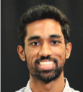
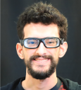
THE TEAM
JENNA STELLMACK
ALEJANDRO FRANQUEZ GARCIA
AVERY HART
KEVIN SUAREZ
ALI CRUZ
LACEY GOLD
SAI SATVIK CHIMMILI
ERIC GASS
VICTOR VALERO

Slide 3
SOLUTION
RISKS
TIMELINE
ACHIEVEMENTS
DEMO
How might we implement AI to teach air traffic communication in an engaging and accessible way?

Slide 4
SOLUTION
RISKS
TIMELINE
ACHIEVEMENTS
DEMO
SOLUTION
Proof of Concept Scenario
Simple scenario // Emphasis on accurate voice communications
Interactive Air Control Tower
Informational displays // Voice control // Live feedback
Two Runways, Two Destinations
Four landing options // Four takeoff options

Slide 5
SOLUTION
RISKS
TIMELINE
ACHIEVEMENTS
DEMO
SOLUTION
RISKS
VR Environment
Testing in VR
Simulated VR controller
Communications
Early voice and AI testing
Early integration into engine/project
Timing & Scope
Jira
Weekly meetings

Slide 6
SOLUTION
RISKS
TIMELINE
RISKS
TIMELINE
ACHIEVEMENTS
DEMO
January 27: Sprint 1 (Pre-Production)
Concept art // Unity project setup // Scenario design // ATC research
February 17: Sprint 2 (First Playable)
Initial models & lighting // AI and voice recognition // 2 flight paths // Airfield blockout // Interaction prototypes
March 10: Sprint 3 (Team Check-In)
Models textured // Plane movement via player input // Plane crashes/loss conditions // Asset pack integration
March 31: Sprint 4
Assets and lighting in tower // Game loop integration // Planes respond to voice control // Control tower interactions
April 21: Sprint 5 (Final Presentation)
Final game loop integration // Polish and bug fixes // Final presentation

Slide 7
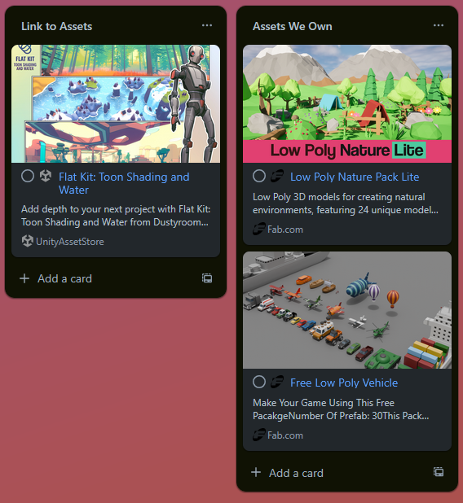
SOLUTION
ACHIEVEMENTS
RISKS
TIMELINE
ACHIEVEMENTS
DEMO
TIMELINE
Initial Models and Lighting
Achievements:
Art style
Simple, stylized
Asset packs
Asset packs selected and in engine
Simple art assets
Retextured runways
Airplane effects
Initial lighting pass
Next Steps:
Art assets
Asset packs
Goals:
Art style
Asset packs
Simple art assets
Initial lighting pass

Slide 8
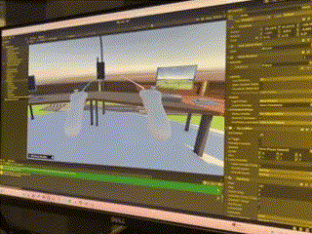
SOLUTION
ACHIEVEMENTS
RISKS
TIMELINE
ACHIEVEMENTS
DEMO
AI and Voice
Next Steps:
Integrate voice commands into AI
Achievements:
AI in engine
Simulated pilots can be interacted with via voice recognition
Pilots can respond audibly with text-to-speech
Voice recognition
Voice recognition in engine
Accessible via radio
Goals:
AI in engine
Simulated pilots from GPT-4
Able to be interacted with by player via text
Voice recognition
Voice recognition in engine
Able to respond to simple keywords

Slide 9
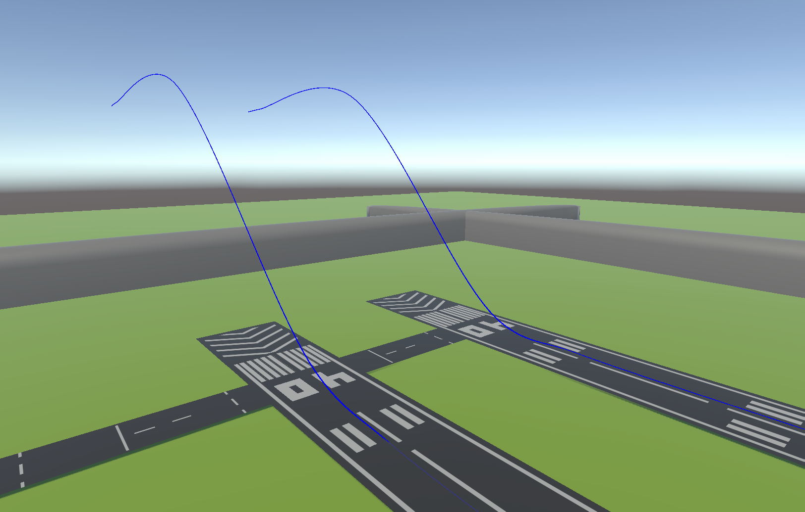
SOLUTION
ACHIEVEMENTS
RISKS
TIMELINE
ACHIEVEMENTS
DEMO
Next Steps:
Art assets
Asset packs
Flight Paths
Goals:
Two Runways
Controllable planes
Achievements:
Two Runways
Controllable planes
Planes can be told to land or touch and go via in-game UI

Slide 10
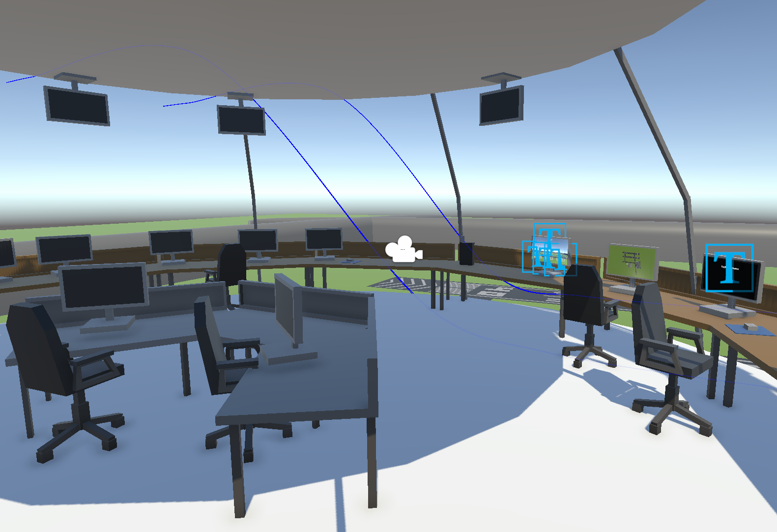
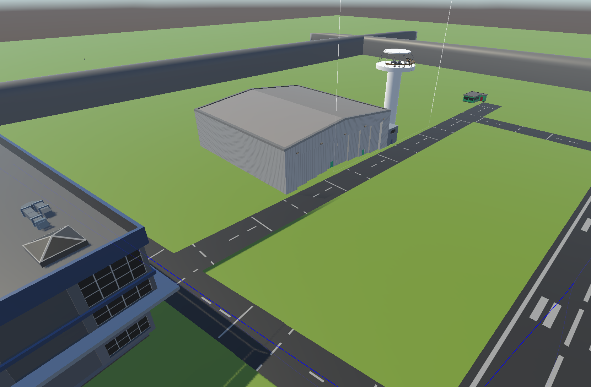
SOLUTION
ACHIEVEMENTS
RISKS
TIMELINE
ACHIEVEMENTS
DEMO
Airfield Blockout
Next Steps:
Fully populate airfield
Add props and clutter to ATC tower
Achievements:
Airfield
Two runways
Simple scenery
ATC Tower
Simple tower for player to move around
Interactive displays
Goals:
Airfield
ATC tower

Slide 11
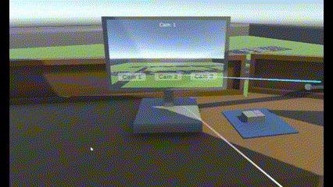
SOLUTION
ACHIEVEMENTS
RISKS
TIMELINE
ACHIEVEMENTS
DEMO
Interaction Prototypes
Next Steps:
Additional interactions
Objects in tower
Additional airfield cameras
Flight information
Win/loss conditions
Achievements:
VR interaction testing
Two runways
Simple scenery
Simple interactive items
Simple tower for player to move around
Interactive displays
Goals:
VR interaction testing
Simple interactive items

Slide 12
SOLUTION
RISKS
TIMELINE
ACHIEVEMENTS
DEMO
January 27: Sprint 1 (Pre-Production)
Concept art // Unity project setup // Scenario design // ATC research
February 17: Sprint 2 (First Playable)
Initial models & lighting // AI and voice recognition // 2 flight paths // Airfield blockout // Interaction prototypes
March 10: Sprint 3 (Team Check-In)
Models textured // Plane movement via player input // Plane crashes/loss conditions // Asset pack integration
Airfield and tower populated with assets
Skyboxes and VFX
Improved plane movement & player control
Put a game in the game

Slide 13
SOLUTION
RISKS
ACHIEVEMENTS
ACHIEVEMENTS
ACHIEVEMENTS
DEMO
TIMELINE
DEMO

